Slide 1
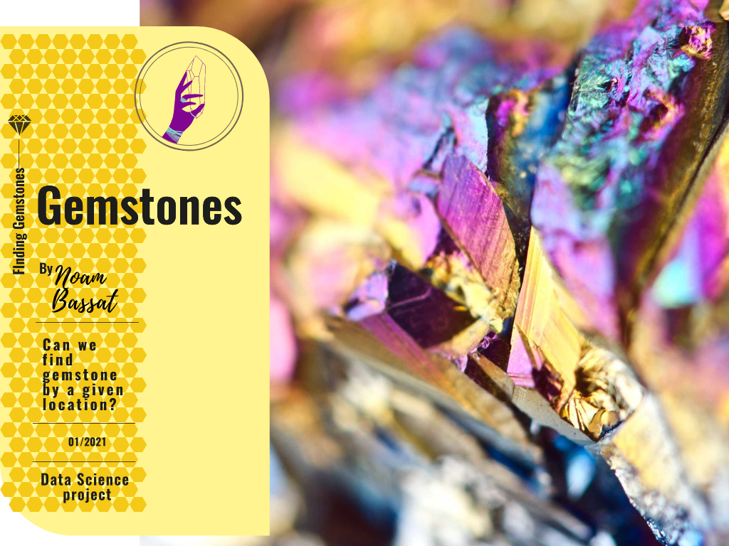

Slide 2
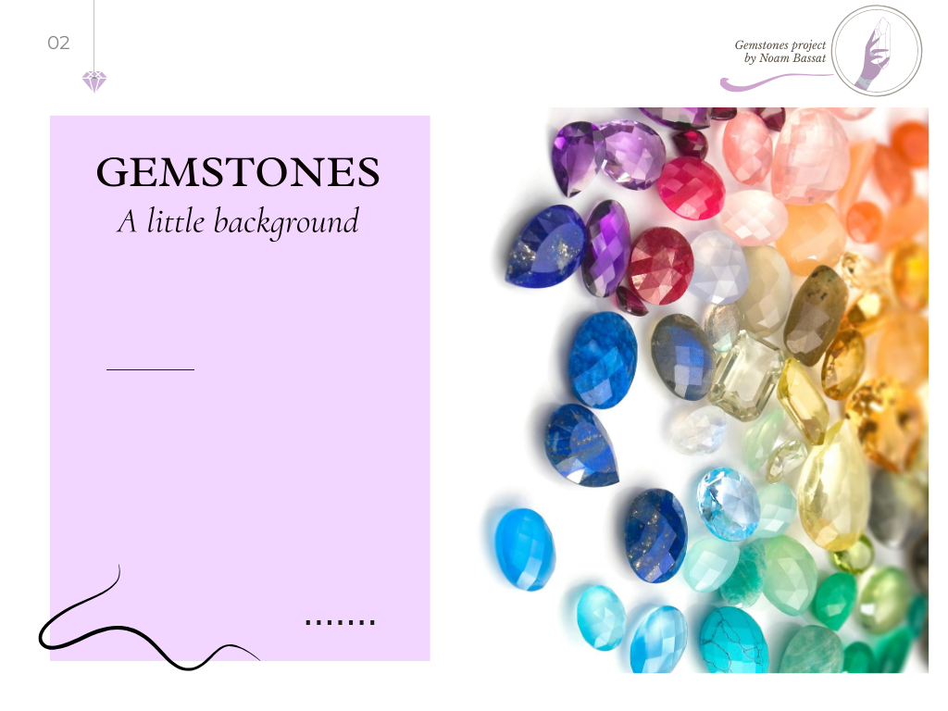

Slide 3
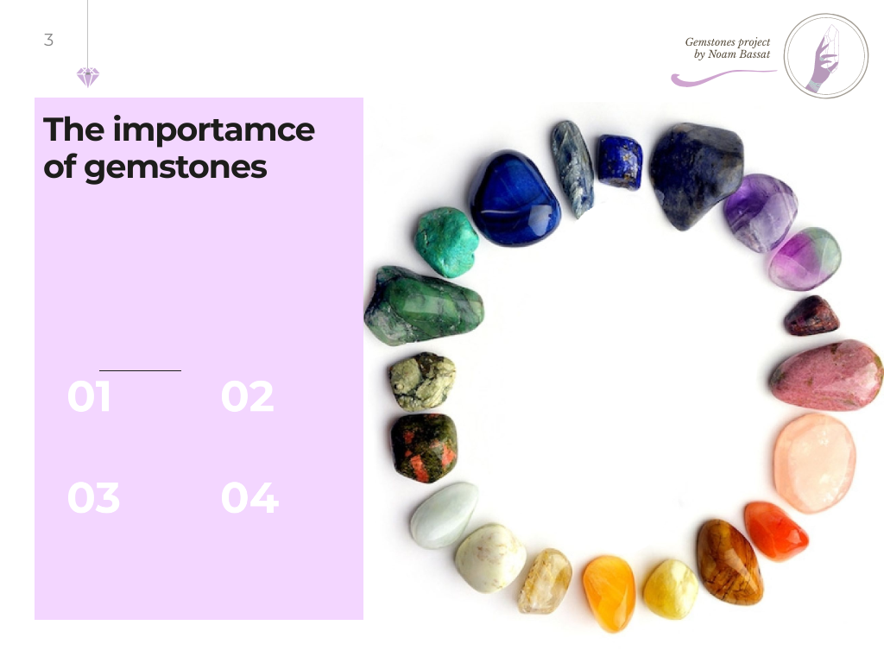

Slide 4
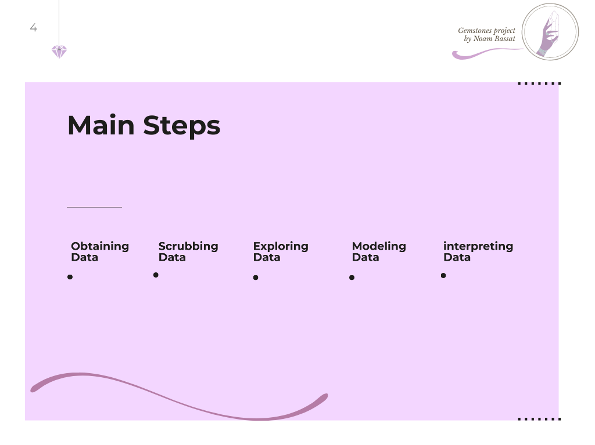
Web crawling for collecting and obtaining the data
Cleaning, formatting, and filtering the data
Visualizing and understanding the data
Clustering the data into groups, modeling and the algorithm
Presentation of data, understanding and delivering the results + Final predict model

Slide 5
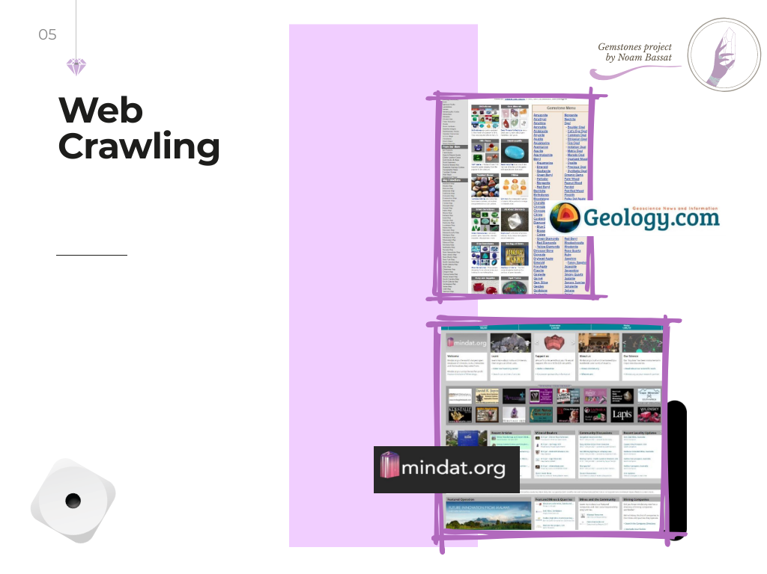
Finding main gemstones to explore, and crawling their data
Gemstones list
Gemstones and Locations
From “mindat.org” I took every relevant information about the gemstone. After I had their locations references, I took the relevant details of each location, and put it into a different dataframe.
From “Geology.com” I took the main gemstones list that I wanted to explore.
Main tools:
BeautifulSoup and Selenium

Slide 6
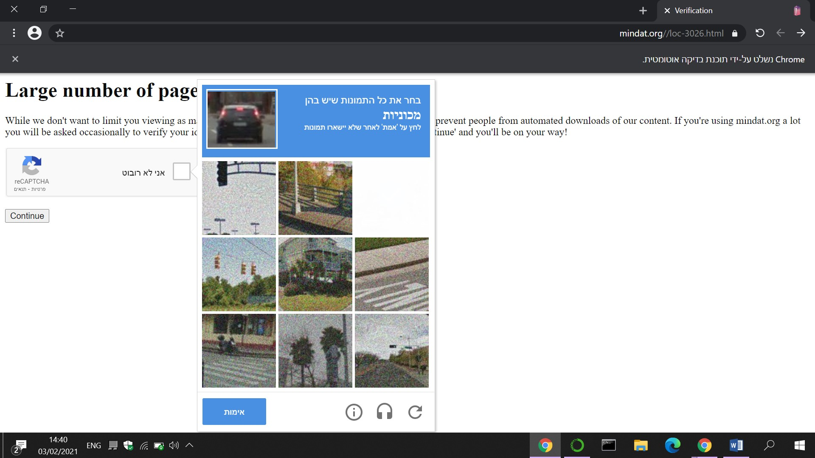
But, not every thing was so easy…
After a number of pages visits, the “Midnat” Site wanted to check if I am a bot. of course I am not, but my program is. So, I made my calculations and found out that this bot-checker appears every 23 minutes. (including the sleeping and searching time). So, I had to stay close, and pass the test every 23 minutes. Finally, after 5 and a half hours, I had a dataset that contains 2,621 locations records, and another dataset that contains information about 77 gemstones.

Slide 7

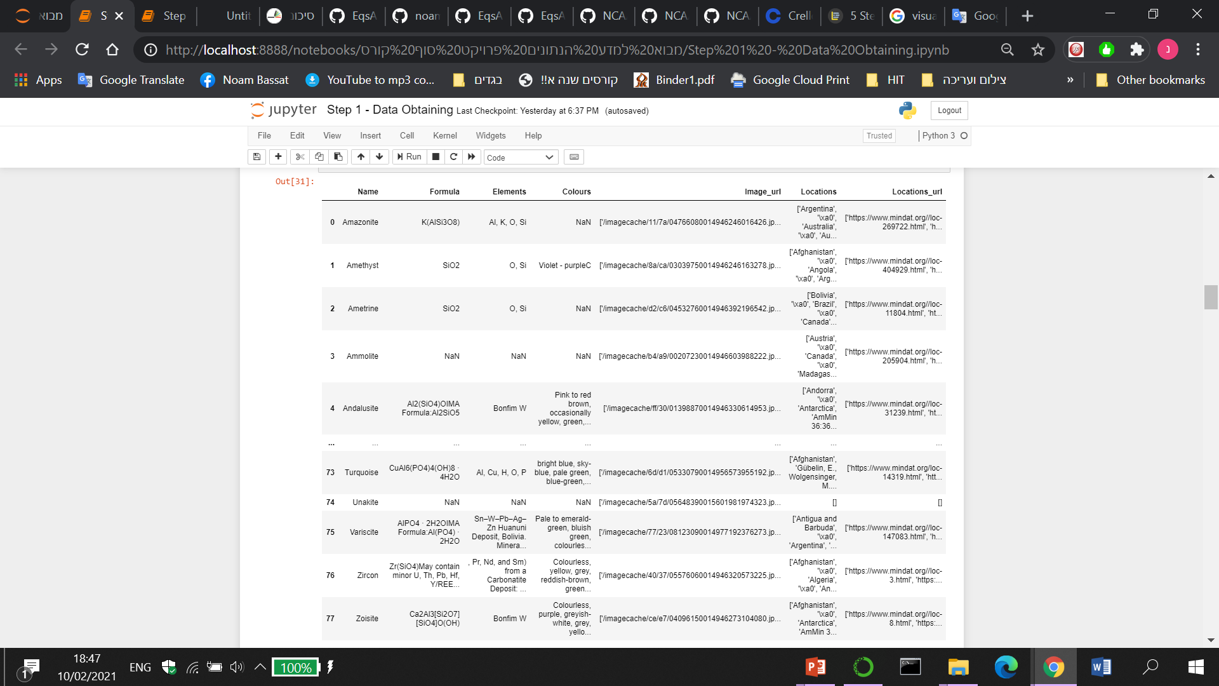
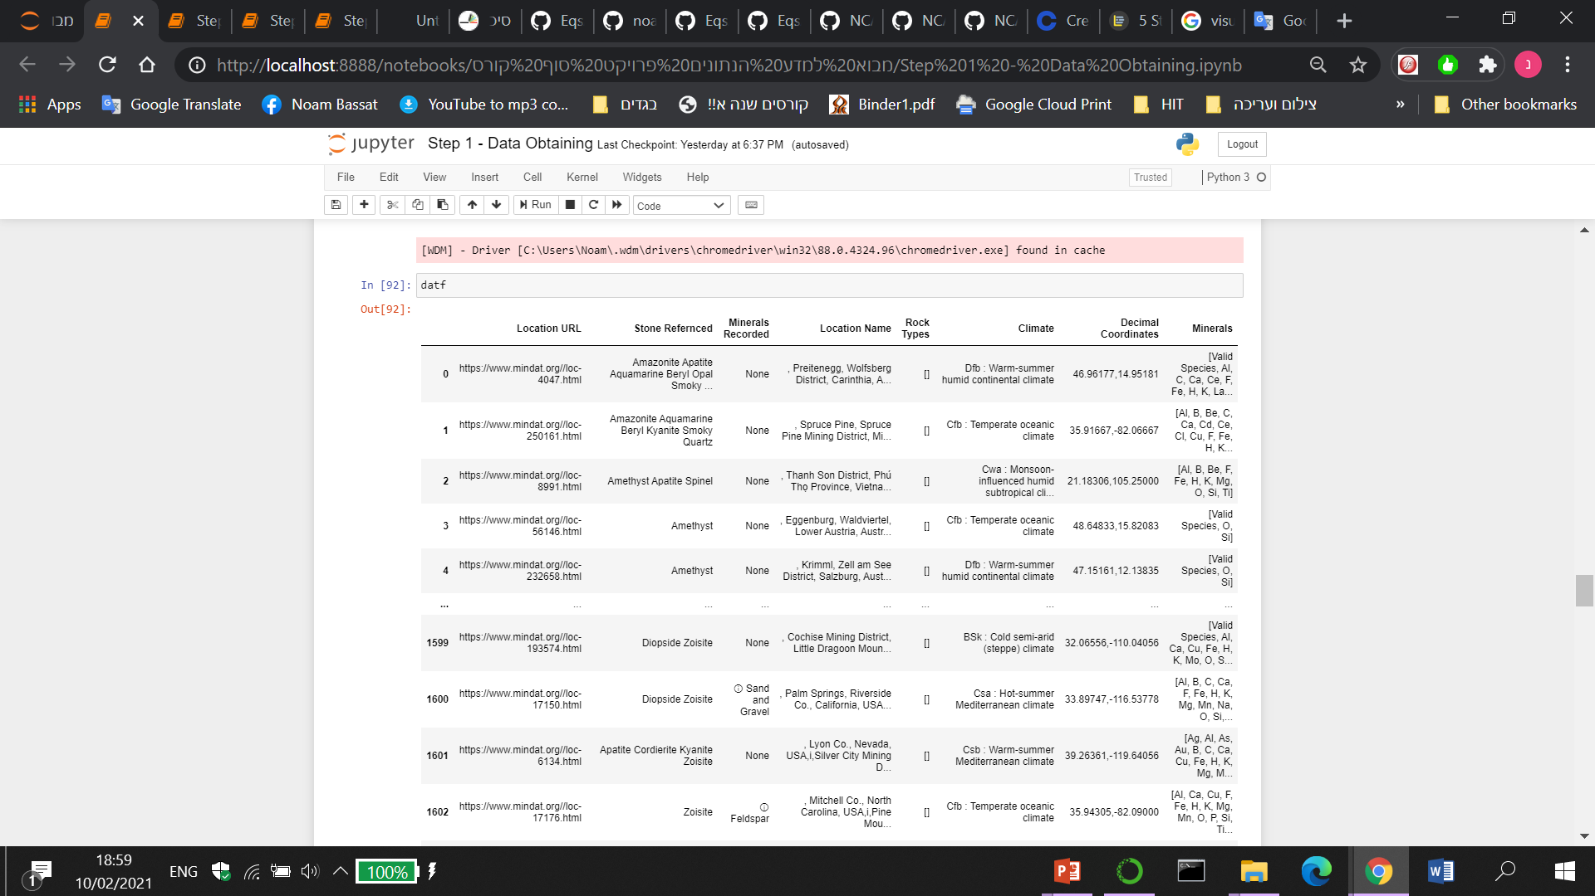
Locations Dataframe
Gemstones Dataframe

Slide 8

Scrubbing Data
Dealing with missing values:
Dropping columns of too many missing values. Manually adding missing climate and coordinates.
Dealing with duplicates;
I have a tiny number of duplicates rows, which contained the exact same values, so I kept only the first ones.
Cleaning the noise:
Many strings contained unnecessary signs, duplicated words and so on, so I built some “cleaning” methods.
Formatting:
Importing every non–numeric variable into a fitted categorical data. Also, splitting columns such as coordinates into two columns, one for the latitude value and one for the longitude.

Slide 9
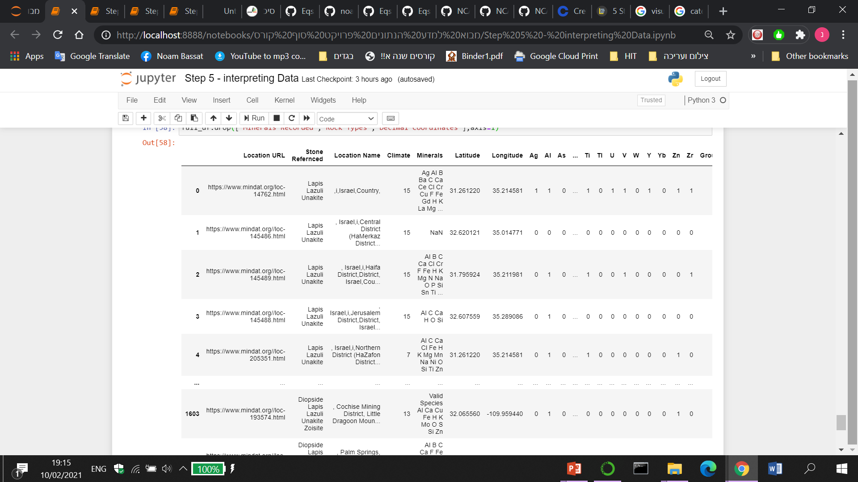
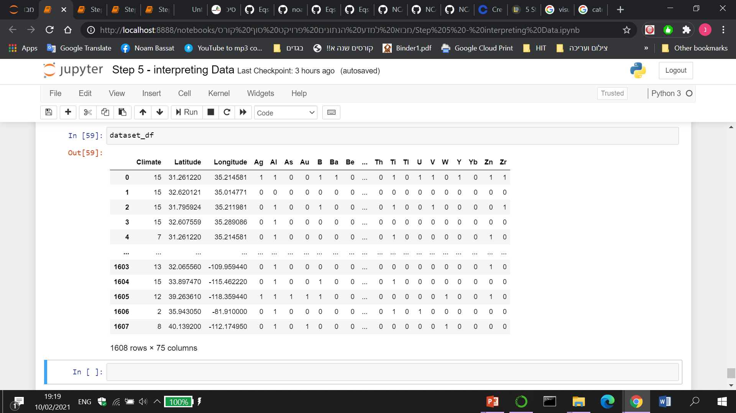
Full - Locations Dataframe
Locations Dataset

Slide 10

Exploring & visualizing the Data

Slide 11
Exploring & visualizing the Data

Slide 12


Slide 13


Slide 14

Cluster 7 | Cluster 6 | Cluster 5 | Cluster 4 | Cluster 3 | Cluster 2 | Cluster 1 | Cluster 0
53 | 125 | 261 | 102 | 104 | 216 | 68 | 679 | Number of locations
42.901839 75.451651- | 19.690474-, 29.756632 | 30.223338, 82.134699 | 39.803252, 123.978676 | 29.315328-, 143.127625 | 39.069659, 112.783420- | 48.719148, 11.227510 | 48.719148, 11.227510 | Average coordinates
19.639860, 94.661670- | 72.000000-, 0.083330 | 4.650000-, 45.083330 | 16.262780, 101.270000 | 75.283330-, 107.731640 | 16.883330, 166.854170- | 7.495260 14.492780- , | 7.495260, 14.492780- | Min Coordinates
67.399170, 44.152500- | 14.000000 72.500000 | 66.916670, 107.200000 | 70.880000, 164.733330 | 2.330250-, 179.958330 | 67.061940, 93.736110- | 79.799840, 51.061020 | 79.799840, 51.061020 | Max Coordinates
1 Dfb : Warm-summer humid continental climate | 7 BSh : Hot semi-arid (steppe) climate | 3 Cwa : Monsoon-influenced humid subtropical climate | 5 Cfa : Humid subtropical climate | 2 Cfb : Temperate oceanic climate | 13 BSk : Cold semi-arid (steppe) climate | 2 Cfb : Temperate oceanic climate | 2 Cfb : Temperate oceanic climate | Most frequent Climate
Ag Al As Au B Ba | Ag Al As Au B Ba Be | Ag Al As Au B | Ag Al As Au B Ba Be | Ag Al As Au B Ba Be Bi | Ag Al As Au B Ba Be | Ag Al As Au B Ba Be Bi Br C Ca Cd Ce | Ag Al As Au B Ba Be Bi | Most significant minerals

Slide 15
Cluster 7 | Cluster 6 | Cluster 5 | Cluster 4 | Cluster 3 | Cluster 2 | Cluster 1 | Cluster 0
Total stones 191 Apatite 29 Sphene 21 Titanite 21 Zircon 17 Diopside 17 Serpentine 7 Spinel 5 Azurite 5 Chrysoberyl 5 Beryl 5 Rhodonite 5 Topaz 5 Zoisite 5 Sodalite 4 Amethyst 4 Opal 3 Quartz 3 Kyanite 3 Cordierite 3 Rhodochrosite 3 Scapolite 3 Ruby 2 Smoky 2 Andalusite 2 Emerald 2 Lepidolite 2 Sapphire 2 Jade 1 Spodumene 1 Nephrite 1 Labradorite 1 Diamond 1 Variscite 1 | Total stones 861 Quartz 92 Smoky 70 Titanite 68 Sphene 68 Zircon 58 Apatite 50 Beryl 44 Diopside 44 Amethyst 38 Serpentine 37 Aquamarine 26 Scapolite 25 Opal 23 Kyanite 22 Rose 18 Spinel 18 Spodumene 15 Azurite 14 Sodalite 9 Lepidolite 9 Andalusite 8 Morganite 8 Heliodor 8 Amazonite 7 Rhodochrosite 7 Topaz 7 Citrine 6 Cordierite 6 Zoisite 5 Sapphire 5 Labradorite 5 Sunstone 5 Variscite 4 Turquoise 4 Chrysoberyl 3 Rhodonite 3 Wood 3 Goshenite 2 Garnet 2 Jadeite 2 Petrified 2 Red 2 Tourmaline 2 Jade 1 Charoite 1 Hematite 1 Nephrite 1 Opalized 1 Ruby 1 Diamond 1 | Total stones 397 Apatite 31 Zircon 27 Beryl 27 Quartz 26 Titanite 24 Sphene 24 Aquamarine 22 Smoky 18 Diopside 15 Topaz 15 Spinel 15 Sapphire 11 Serpentine 11 Amethyst 10 Lepidolite 9 Ruby 9 Opal 8 Emerald 8 Rose 8 Goshenite 8 Azurite 7 Kyanite 7 Sodalite 7 Morganite 6 Diamond 6 Spodumene 6 Andalusite 5 Chrysoberyl 5 Cordierite 4 Zoisite 3 Scapolite 3 Citrine 2 Labradorite 1 Tourmaline 1 Garnet 1 Iolite 1 Amazonite 1 Variscite 1 Rhodonite 1 Chrysoprase 1 Rhodochrosite 1 Peridot 1 | Total stones 211 Apatite 26 Zircon 22 Beryl 14 Quartz 12 Aquamarine 12 Titanite 11 Sphene 11 Smoky 10 Emerald 8 Spinel 7 Diopside 7 Amethyst 6 Opal 6 Spodumene 5 Lepidolite 5 Kyanite 4 Cordierite 4 Serpentine 4 Chrysoberyl 3 Zoisite 3 Azurite 3 Wood 3 Rose 2 Sapphire 2 Goshenite 2 Citrine 2 Diamond 2 Topaz 2 Opalized 2 Andalusite 2 Jadeite 2 Morganite 2 Labradorite 1 Rhodochrosite 1 Petrified 1 Rhodonite 1 Sodalite 1 | Total stones 504 Apatite 49 Titanite 37 Sphene 37 Diopside 35 Zircon 34 Spinel 25 Quartz 20 Serpentine 20 Beryl 20 Aquamarine 18 Smoky 16 Amethyst 16 Topaz 15 Azurite 15 Sapphire 12 Ruby 12 Cordierite 11 Andalusite 9 Scapolite 9 Lepidolite 7 Spodumene 7 Sodalite 7 Rhodochrosite 6 Heliodor 6 Emerald 6 Chrysoberyl 5 Moonstone 5 Rhodonite 4 Zoisite 4 Goshenite 4 Morganite 4 Labradorite 4 Rose 4 Kyanite 3 Opal 2 Citrine 2 Turquoise 2 Aventurine 2 Jadeite 2 Iolite 1 Fire 1 Agate 1 Petrified 1 Wood 1 Tourmaline 1 Sunstone 1 Peridot 1 | Total stones 766 Quartz 56 Azurite 51 Apatite 50 Zircon 44 Smoky 40 Diopside 39 Opal 37 Sphene 36 Beryl 36 Titanite 36 Amethyst 34 Serpentine 32 Rhodochrosite 31 Aquamarine 20 Rose 14 Rhodonite 14 Spinel 12 Wood 12 Morganite 12 Heliodor 12 Andalusite 12 Zoisite 10 Topaz 10 Petrified 10 Citrine 10 Spodumene 9 Lepidolite 9 Scapolite 8 Cordierite 8 Goshenite 6 Turquoise 6 Kyanite 6 Sodalite 4 Chrysoberyl 3 Variscite 3 Sapphire 3 Diamond 3 Nephrite 3 Jade 3 Labradorite 3 Emerald 2 Ruby 2 Moonstone 2 Opalized 2 Amazonite 1 Benitoite 1 Fluorite 1 Bloodstone 1 Agate 1 Opalite 1 Hematite 1 Tourmaline 1 Iris 1 Sunstone 1 Peridot 1 | Total stones 2348 Titanite 252 Sphene 252 Apatite 206 Zircon 186 Quartz 169 Smoky Quartz 154 Diopside 116 Azurite 103 Amethyst 86 Beryl 82 Serpentine 81 Spinel 64 Opal 55 Andalusite 49 Cordierite 47 Kyanite 46 Zoisite 46 Aquamarine 42 Rhodochrosite 38 Topaz 31 Scapolite 28 Sodalite 28 Labradorite 18 Rhodonite 16 Sapphire 14 Rose 12 Lepidolite 11 Diamond 11 Variscite 10 Chrysoberyl 9 Turquoise 9 Ruby 9 Citrine 8 Wood 7 Petrified 5 Spodumene 5 Heliodor 4 Emerald 4 Jadeite 3 Goshenite 2 Iolite 2 Gaspeite 2 Garnet 2 Opalized 2 Jade 2 Moonstone 2 Bloodstone 2 Nephrite 2 Sit 2 Amazonite 2 Fluorite 2 Chrysoprase 1 Maw 1 Fire 1 Malachite 1 Sunstone 1 Hematite 1 Moldavite 1 Agate 1 | Total stones 319 Apatite 30 Zircon 24 Diopside 20 Titanite 19 Sphene 19 Quartz 17 Beryl 16 Opal 16 Azurite 15 Smoky Quartz 14 Spinel 10 Serpentine 10 Aquamarine 8 Sapphire 8 Topaz 8 Scapolite 7 Zoisite 6 Emerald 6 Variscite 5 Diamond 5 Lepidolite 4 Kyanite 4 Heliodor 4 Amethyst 4 Rhodochrosite 4 Andalusite 4 Ruby 3 Turquoise 3 Cordierite 3 Gaspeite 2 Goshenite 2 Rhodonite 2 Rose Quartz 2 Sodalite 2 Moonstone 2 Wood 2 Spodumene 2 Chrysoprase 1 Jade 1 Amazonite 1 Malachite 1 Sphalerite 1 Petrified 1 Opalized 1

Slide 16
Accuracy change based on features

Slide 17
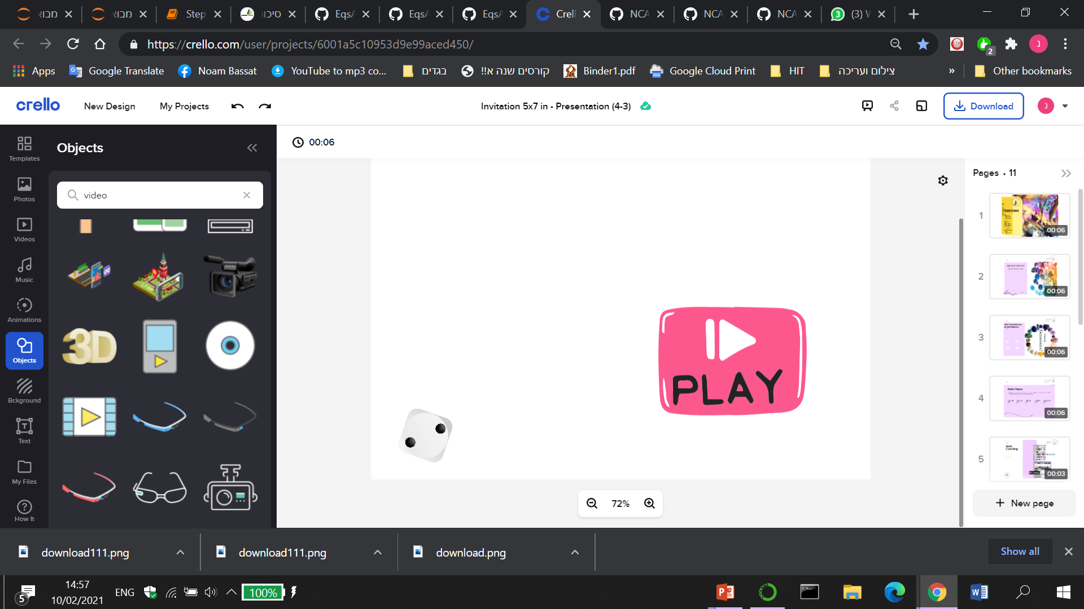
My Machine

Slide 18
+Bonus:
The rarest stones in the world

Slide 19
Conclusions
If you will find gemstones, you most likely find also “Lapis Lazuli” and “Unakite”. They came out in every single location where stones found. Apatite is also a very common stone.
Finally, you can predict stone group by a given location. The location’s coordinates are more then enough feature.
With a little more time I would…
Develop the rare-stone dataframe, and build an algorithm that predict the exact locations, by a given rare-stone name.
Make a geology research, and add some relative geologic-based features.

